Slide 1
EPFL Space Center eSpace
Space Propulsion ENG-510

Slide 2
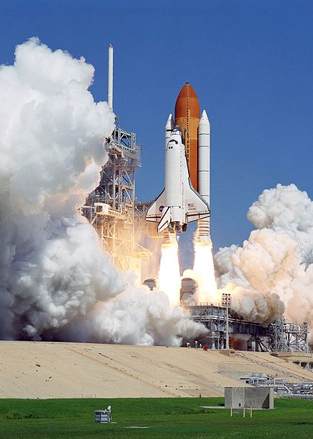
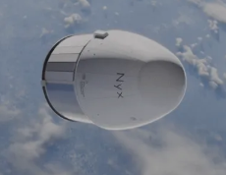
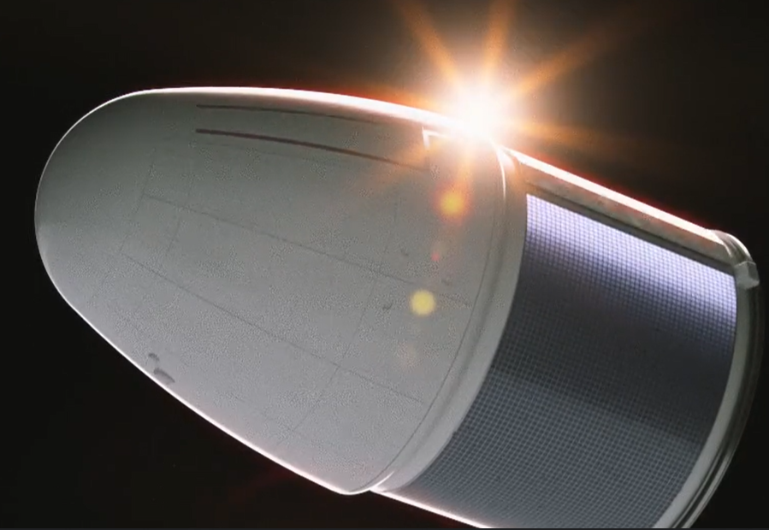
Lecture # 3 Exercise
Propulsion subsystem design for a LEO cargo return capsule

Slide 3
Which Propulsion System for LEO Capsule?
Objective: To understand propulsion system selection process
Design the propulsion subsystem for a LEO cargo return capsule
Dry mass of 10 tons
Mission duration of 6 months
L3 – LEO Capsule
Space Propulsion ENG-510

Slide 4
Which Propulsion System for LEO Capsule?
Objective: To understand propulsion system selection process
Design the propulsion subsystem for a LEO cargo return capsule
To develop a vehicle, its associated infrastructure and operations, capable of delivering pressurized cargo to human outposts in LEO and returning cargo to Earth (basic configuration)
To execute a demonstration mission to the ISS targeting a launch date before the end of 2029
To ensure that the vehicle, its associated infrastructure and operations, are compatible with the evolutions to a crew transportation service to human outposts in LEO (evolution step 1) and to a cargo return service from Gateway in cis-lunar orbit without major modifications of the architecture (evolution step 2)
L3 – LEO Capsule
Space Propulsion ENG-510

Slide 5
Which Propulsion System for LEO Capsule?
Objective: To understand propulsion system selection process
Main requirements (L0 – Level 0):
Maiden flight with demo to ISS before end 2029
Upload 4 ton pressurized cargo to LEO
Cargo density of 260 kg / m³
Download 2 ton pressurized cargo
Competitive price / kg on LEO market
< 75 k€ / kg for pressurized cargo upload
3.5 ton mission => 260 M€
L3 – LEO Capsule
Space Propulsion ENG-510

Slide 6
Which Propulsion System for LEO Capsule?
Objective: To understand propulsion system selection process
Main requirements (L0 – Level 0):
Versatility / growth potential for evolution towards
LEO crewed missions (a minimum crew size of 3, a docked mission duration of 210 days and an autonomous flight duration consistent with the phasing, rendezvous, and re-entry concepts, including contingencies)
Download 2 ton cargo mission from Lunar Gateway
L3 – LEO Capsule
Space Propulsion ENG-510

Slide 7
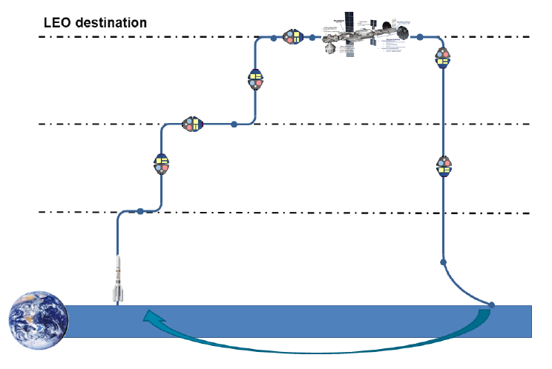
Which Propulsion System for LEO Capsule?
Docking / Un-docking
L3 – LEO Capsule
Holding
plane
Space Propulsion ENG-510
Launcher
separation
Re-entry
Landing

Slide 8
Which Propulsion System for LEO Capsule?
Objective: To understand propulsion system selection process
Propulsion system selection (we consider launch abort system as part of launch vehicle):
Which propulsion technology might fit to LEO cargo return capsule?
Electrical propulsion
Electromagnetic acceleration (MPD thruster, pulsed plasma thruster, magnetic nozzle thruster)
Electrostatic acceleration (gridded ion thruster, hall effect thruster, field emission EP, electrospray thruster)
Electrothermal acceleration (resistojet thruster, arcjet thruster)
L3 – LEO Capsule
Space Propulsion ENG-510

Slide 9
Which Propulsion System for LEO Capsule?
Objective: To understand propulsion system selection process
Propulsion system selection (we consider launch abort system as part of launch vehicle):
Which propulsion technology might fit to LEO cargo return capsule?
Thermal propulsion
Nuclear thermal thruster
Solar thermal thruster
Cold gas thruster
Chemical propulsion
Gaseous
Liquid
Solid
Hybrid
L3 – LEO Capsule
Space Propulsion ENG-510

Slide 10
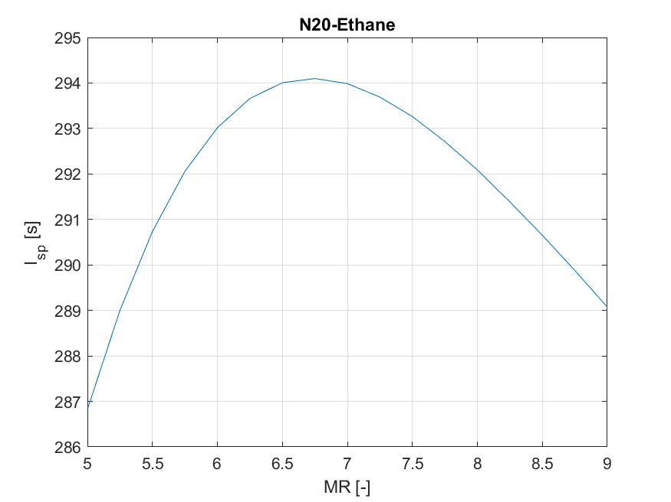
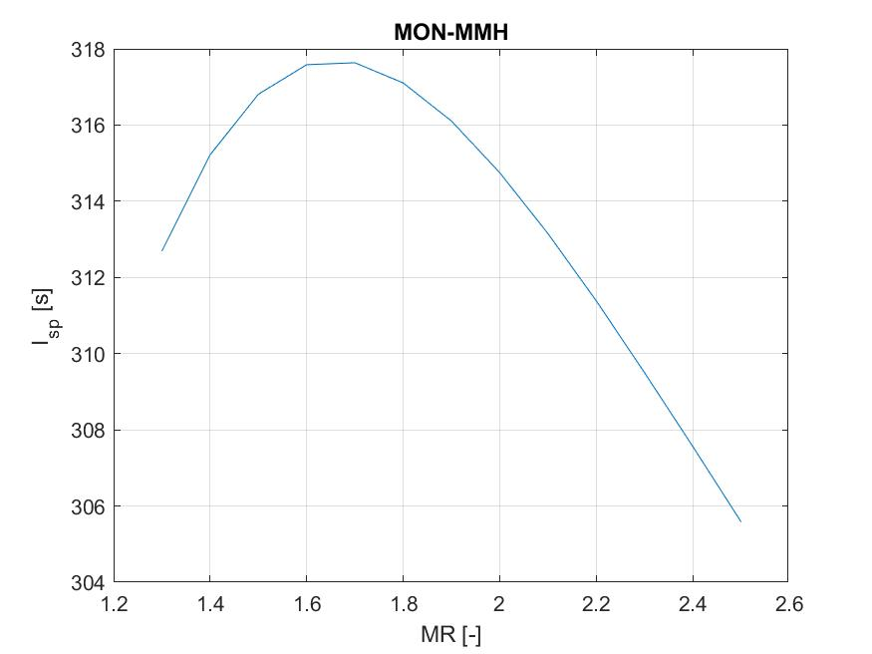
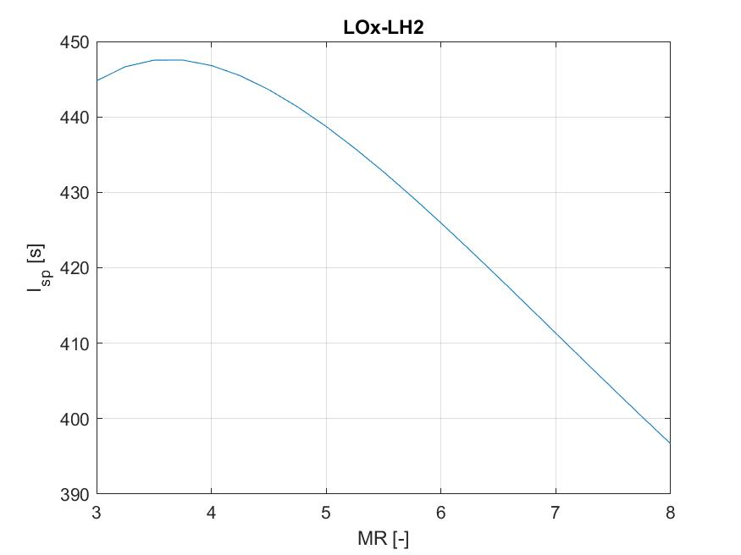
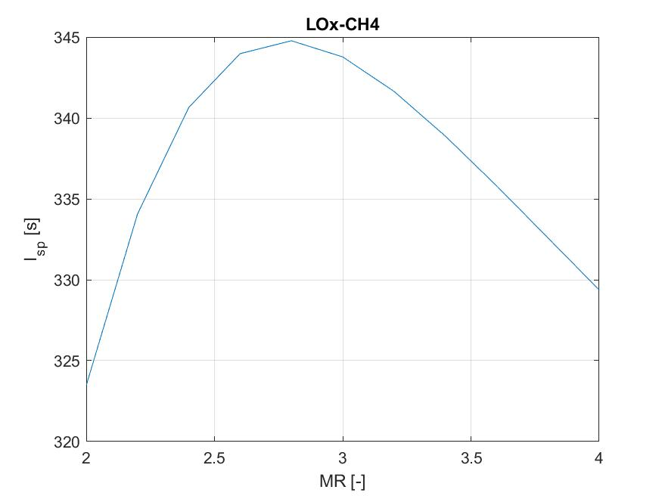
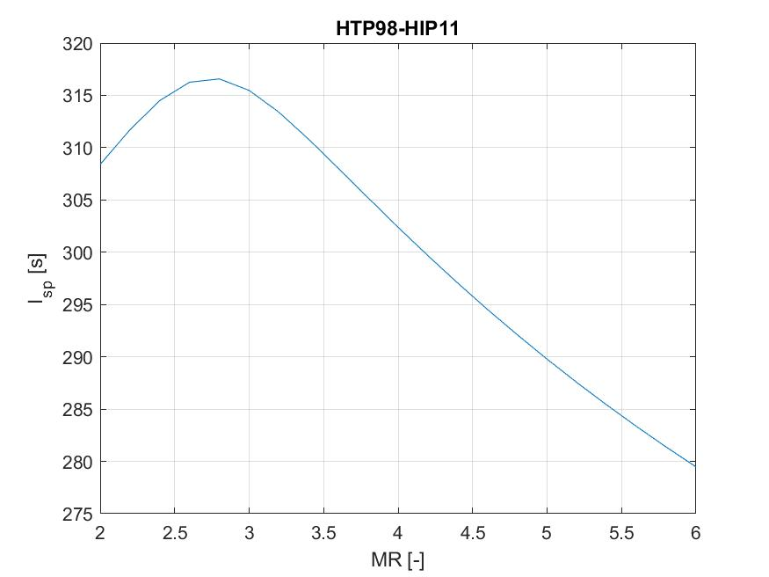
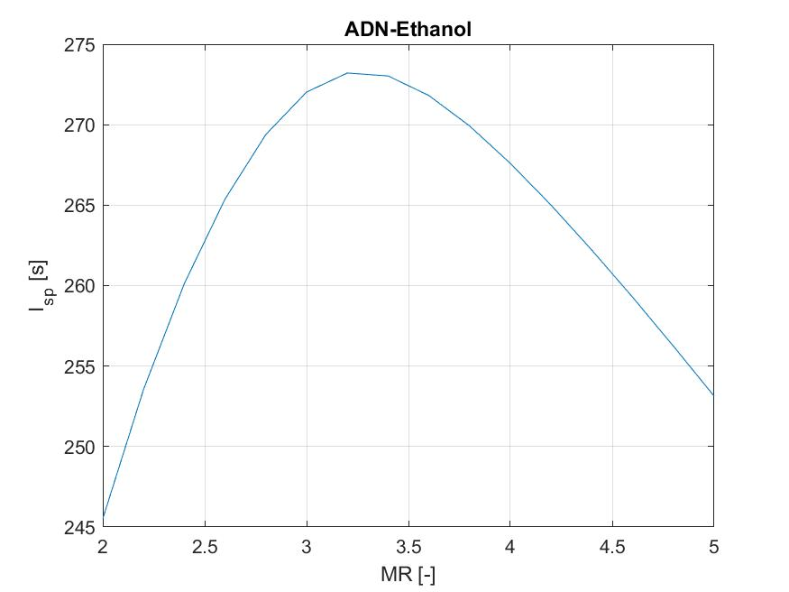
Which Propulsion System for LEO Capsule?
L2 – ∆v & LEO Capsule
Space Propulsion ENG-510

Slide 11
Which Propulsion System for LEO Capsule?
Objective: To understand propulsion system selection process
Propulsion system selection (we consider launch abort system as part of launch vehicle):
Which propulsion technology might fit to LEO cargo return capsule?
Electrical propulsion
Electromagnetic acceleration (MPD thruster, pulsed plasma thruster, magnetic nozzle thruster)
Electrostatic acceleration (gridded ion thruster, hall effect thruster, field emission EP, electrospray thruster)
Electrothermal acceleration (resistojet thruster, arcjet thruster)
L3 – LEO Capsule
Space Propulsion ENG-510

Slide 12
Which Propulsion System for LEO Capsule?
Objective: To understand propulsion system selection process
Propulsion system selection (we consider launch abort system as part of launch vehicle):
Which propulsion technology might fit to LEO cargo return capsule?
Thermal propulsion
Nuclear thermal thruster
Solar thermal thruster
Cold gas thruster
Chemical propulsion
Gaseous
Liquid
Solid
Hybrid
L3 – LEO Capsule
Space Propulsion ENG-510

Slide 13
Which Propulsion System for LEO Capsule?
Objective: To understand propulsion system selection process
Design the propulsion subsystem for a LEO cargo return capsule
Dry mass of 10 tons
Mission duration of 6 months
L3 – LEO Capsule
Space Propulsion ENG-510

Slide 14
Which Propulsion System for LEO Capsule?
Objective: To understand propulsion system selection process
Propulsion system selection (we consider launch abort system as part of launch vehicle):
Which propulsion technology might fit to LEO cargo return capsule?
Thermal propulsion
Cold gas thruster
Chemical propulsion
Gaseous
Liquid
L3 – LEO Capsule
Space Propulsion ENG-510

Slide 15
Which Propulsion System for LEO Capsule?
Objective: To understand propulsion system selection process
Which propulsion technology might fit to LEO cargo return capsule?
Propulsion technology trade
L3 – LEO Capsule
Space Propulsion ENG-510

Slide 16
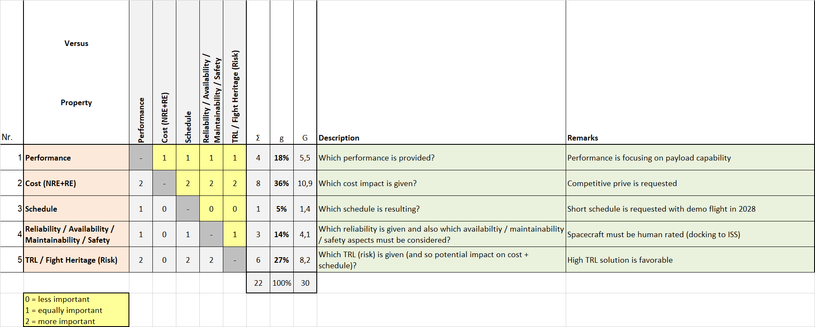
Which Propulsion System for LEO Capsule?
Objective: To understand propulsion system selection process
B
C
L3 – LEO Capsule
Space Propulsion ENG-510

Slide 17
Which Propulsion System for LEO Capsule?
Objective: To understand propulsion system selection process
Which performance is required for LEO cargo return capsule?
Are the customer (L0) requirements sufficient?
Delta v…
Thrust…
Isp…
L3 – LEO Capsule
Space Propulsion ENG-510

Slide 18
Which Propulsion System for LEO Capsule?
Objective: To understand propulsion system selection process
Which performance is required for LEO cargo return capsule?
Are the customer (L0) requirements sufficient?
Delta v need is about 500 m/s for LEO cargo return capsule
Thrust need differs between attitude control and delta v maneuvers
Attitude control requires pulse mode firing with small MIB
Delta v maneuver require steady state firing with sufficient thrust
Thrust level of 20 N is good starting point for attitude control thrusters
Thrust level of 200 N is reasonable for delta v thrusters (considering 4 thrusters running in parallel)
Isp depends on propellant combination
L3 – LEO Capsule
Space Propulsion ENG-510

Slide 19
Which Propulsion System for LEO Capsule?
Objective: To understand propulsion system selection process
Which performance is required for LEO cargo return capsule?
Isp…
Isp depends on propellant combination
L3 – LEO Capsule
Space Propulsion ENG-510

Slide 20
Which Propulsion System for LEO Capsule?
L2 – ∆v & LEO Capsule
Space Propulsion ENG-510

Slide 21
Which Propulsion System for LEO Capsule?
Objective: To understand propulsion system selection process
Which performance is required for LEO cargo return capsule?
Isp…
Isp depends on propellant combination
Rocket CEA
Propellant data from REFPROP (computer program developed by the National Institute of Standards and Technology (NIST). NIST database contains the thermophysical data of several fluids in the gas, liquid and supercritical state which are accessible through a Python request calling the REFPROP library)
L3 – LEO Capsule
Space Propulsion ENG-510

Slide 22
Which Propulsion System for LEO Capsule?
Objective: To understand propulsion system selection process
Which propulsion technology might fit to LEO cargo return capsule?
Any impact by evolution step 1? Crew of 3 on board?
L3 – LEO Capsule
Space Propulsion ENG-510

Slide 23
Which Propulsion System for LEO Capsule?
Objective: To understand propulsion system selection process
Which propulsion technology might fit to LEO cargo return capsule?
Any impact by evolution step 1? Crew of 3 on board?
Oxygen
Nitrogen
CO2 carbon dioxide
Water
L3 – LEO Capsule
Space Propulsion ENG-510

Slide 24
Which Propulsion System for LEO Capsule?
Objective: To understand propulsion system selection process
Which propulsion technology might fit to LEO cargo return capsule?
Any impact by evolution step 1? Crew of 3 on board?
Electrolyser
L3 – LEO Capsule
Space Propulsion ENG-510

Slide 25
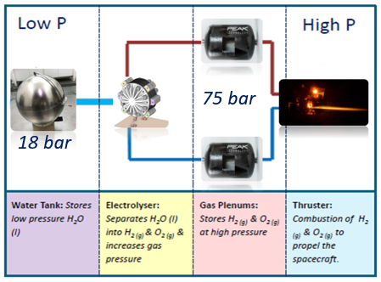
Which Propulsion System for LEO Capsule?
Objective: To understand propulsion system selection process
Which propulsion technology might fit to LEO cargo return capsule?
Any impact by evolution step 1? Crew of 3 on board?
Electrolyser
L3 – LEO Capsule
Space Propulsion ENG-510

Slide 26
Which Propulsion System for LEO Capsule?
Objective: To understand propulsion system selection process
Which propulsion technology might fit to LEO cargo return capsule?
Any impact by evolution step 1? Crew of 3 on board?
Sabatier reactor
L3 – LEO Capsule
Space Propulsion ENG-510

Slide 27
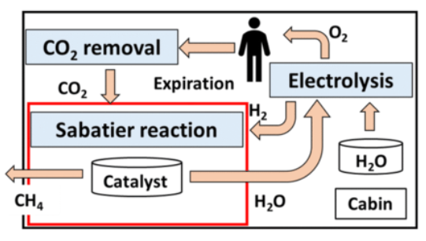
Which Propulsion System for LEO Capsule?
Objective: To understand propulsion system selection process
Which propulsion technology might fit to LEO cargo return capsule?
Any impact by evolution step 1? Crew of 3 on board?
Sabatier reactor
L3 – LEO Capsule
Space Propulsion ENG-510

Slide 28
Which Propulsion System for LEO Capsule?
Objective: To understand propulsion system selection process
Which propulsion technology might fit to LEO cargo return capsule?
Any impact by evolution step 1? Crew of 3 on board?
Electrolyser + Sabatier Reactor
L3 – LEO Capsule
Space Propulsion ENG-510

Slide 29
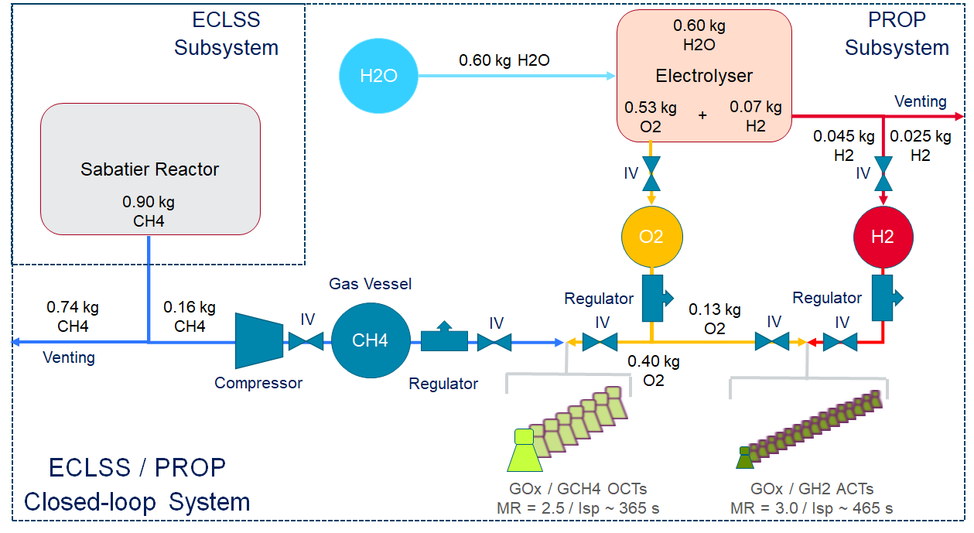
Which Propulsion System for LEO Capsule?
Objective: To understand propulsion system selection process
Which propulsion technology might fit to LEO cargo return capsule?
Any impact by evolution step 1? Crew of 3 on board?
Electrolyser + Sabatier Reactor
L3 – LEO Capsule
Space Propulsion ENG-510

Slide 30
Which Propulsion System for LEO Capsule?
Objective: To understand propulsion system selection process
Which propulsion technology might fit to LEO cargo return capsule?
Any impact by evolution step 2? Docking to Lunar Gateway?
L3 – LEO Capsule
Space Propulsion ENG-510

Slide 31
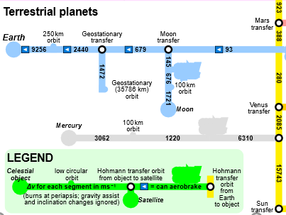
Which Propulsion System for LEO Capsule?
Objective: To understand propulsion system selection process
Which propulsion technology might fit to LEO cargo return capsule?
Any impact by evolution step 2? Docking to Lunar Gateway?
Delta v need of 4 km / s
L3 – LEO Capsule
Space Propulsion ENG-510

Slide 32
Which Propulsion System for LEO Capsule?
Objective: To understand propulsion system selection process
Which propulsion technology might fit to LEO cargo return capsule?
Final selection?
L3 – LEO Capsule
Space Propulsion ENG-510

Slide 33
Which Propulsion System for LEO Capsule?
Objective: To understand propulsion system selection process
Which propulsion technology might fit to LEO cargo return capsule?
Final selection?
So this was the easy part. Let’s continue with some more difficult topics…
L3 – LEO Capsule
Space Propulsion ENG-510

Slide 34
Which Propulsion System for LEO Capsule?
Objective: To understand propulsion system selection process
Propulsion system design:
Budgets?
L3 – LEO Capsule
Space Propulsion ENG-510

Slide 35
Which Propulsion System for LEO Capsule?
Objective: To understand propulsion system selection process
Propulsion system design:
Budgets?
Propellant budget
Pressurant budget
Mass budget
Power budget
Pressure budget
Temperature budget
L3 – LEO Capsule
Space Propulsion ENG-510

Slide 36
Which Propulsion System for LEO Capsule?
Objective: To understand propulsion system selection process
Propulsion system design:
Functional break-down?
L3 – LEO Capsule
Space Propulsion ENG-510

Slide 37
Which Propulsion System for LEO Capsule?
Objective: To understand propulsion system selection process
Propulsion system design:
Functional break-down?
To provide axial thrust (delta v maneuver)
To provide orbital control (attitude control maneuver)
To load propellant
To store propellant
To feed propellant
To monitor propulsion system (pressure, temperature, …)
To operate valves
To control temperature
L3 – LEO Capsule
Space Propulsion ENG-510

Slide 38
Which Propulsion System for LEO Capsule?
Objective: To understand propulsion system selection process
Propulsion system design:
Functional matrices?
L3 – LEO Capsule
Space Propulsion ENG-510

Slide 39
Which Propulsion System for LEO Capsule?
Objective: To understand propulsion system selection process
Propulsion system design:
Functional matrices?
Functions versus phases
Functions versus products
L3 – LEO Capsule
Space Propulsion ENG-510
Function | Ground phase | Ascent phase | Orbital phase | De-orbit phase
F1 Axial thrust |  |  | X | X
F2 Orbital control |  |  | X | X
Function | Pressure vessel | Tank | Valve | Thruster
F1 Axial thrust | X | X | X | X
F2 Orbital control | X | X | X | X

Slide 40
Which Propulsion System for LEO Capsule?
Objective: To understand propulsion system selection process
Propulsion system design:
Interfaces?
L3 – LEO Capsule
Space Propulsion ENG-510

Slide 41
Which Propulsion System for LEO Capsule?
Objective: To understand propulsion system selection process
Propulsion system design:
Interfaces?
Electrical interface
Mechanical interface
Thermal interface
Structural interface
Communication interface
L3 – LEO Capsule
Space Propulsion ENG-510

Slide 42
Which Propulsion System for LEO Capsule?
Objective: To understand propulsion system selection process
Propulsion system design:
Requirements?
L3 – LEO Capsule
Space Propulsion ENG-510

Slide 43
Which Propulsion System for LEO Capsule?
Objective: To understand propulsion system selection process
Propulsion system design:
Requirements?
L1 System
L2 Subsystem
L3 Equipment
L3 – LEO Capsule
Space Propulsion ENG-510

Slide 44
Which Propulsion System for LEO Capsule?
Objective: To understand propulsion system selection process
Propulsion system design:
Alert!
L3 – LEO Capsule
Space Propulsion ENG-510

Slide 45
Which Propulsion System for LEO Capsule?
Objective: To understand propulsion system selection process
Propulsion system design:
Alert!
Dry mass increase of 1 ton
MBSE – Model Based System Engineering
Any changes to propulsion system selection?
L3 – LEO Capsule
Space Propulsion ENG-510

Slide 46
Which Propulsion System for LEO Capsule?
Objective: To understand propulsion system selection process
Propulsion system design:
Mayday!
L3 – LEO Capsule
Space Propulsion ENG-510

Slide 47
Which Propulsion System for LEO Capsule?
Objective: To understand propulsion system selection process
Propulsion system design:
Mayday!
Did we consider RAMS / safety?
Quality control?
Configuration management?
L3 – LEO Capsule
Space Propulsion ENG-510

